Slide 1
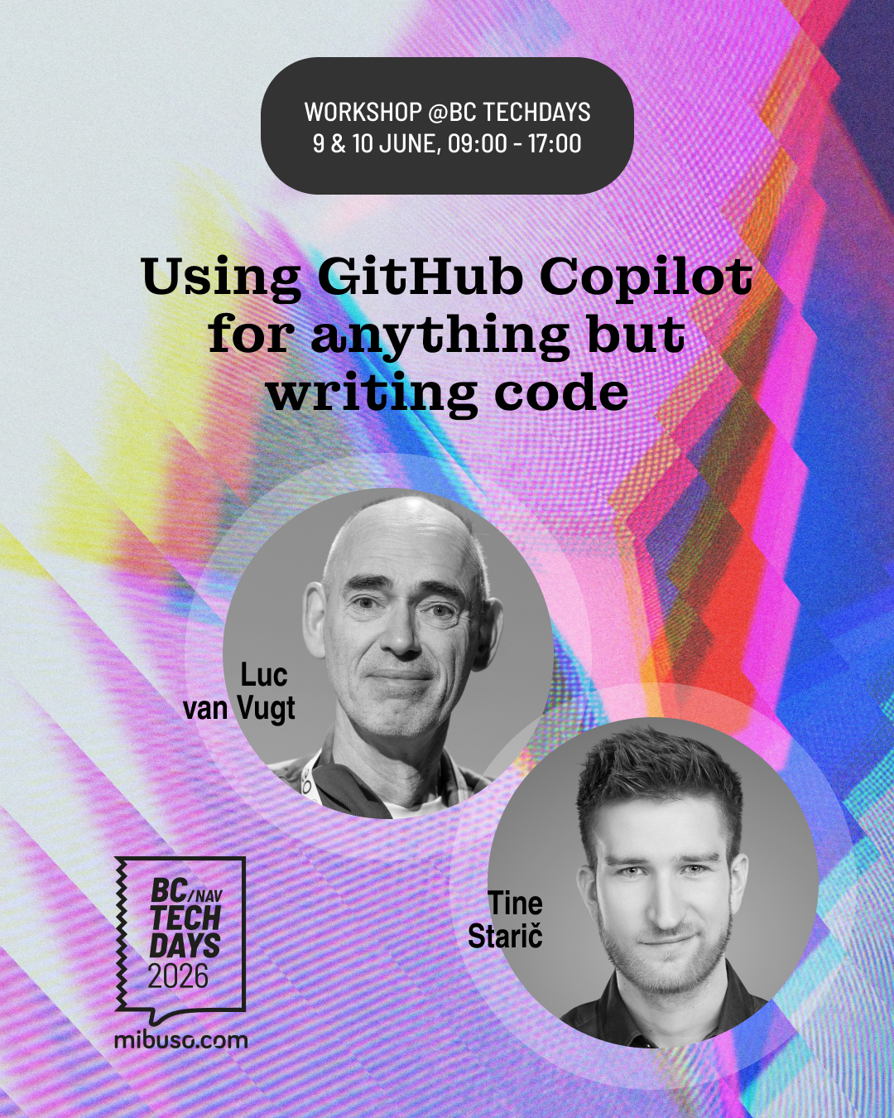
WORKSHOP @BC TECHDAYS
Using GitHub Copilot
for anything but writing code.
GitHub Copilot is awesome. It writes code.
Today, it does everything else.
9 & 10 June 2026 | 09:00–17:00
Tine Starič & Luc van Vugt
mibuso.com
Notes:
Let the room settle. This slide stays up while people walk in and get coffee.

Slide 2
Welcome.
Tine Starič
Luc van Vugt
Technology Strategist, Companial
Microsoft MVP – Business Applications
BC trainer, author & community lead
Microsoft MVP – Business Applications
This is hands-on, opinionated, and group-paced.
Not a coding workshop. Not a pitch. Not sit-and-watch.
Notes:
Short intro from both — one minute each. Keep it moving. Don't linger here.

Slide 3
Have you accepted the Azure DevOps invitation yet?

Slide 4
The day at a glance
9:00
9:30
10:30
10:45
12:00
13:00
14:15
14:30
15:30
16:30
Welcome
M1: MCPs
Break
M2: Agents
Lunch
M3: Sub-agents
Break
M4: Skills
M5: BG Agents
Closing
You are here
Notes:
Timetable — "you are here": Welcome (9:00).

Slide 5

Jeremy Vyska
Messy screenshot of a customer architecture → working integration.
~1 hour.

Slide 6
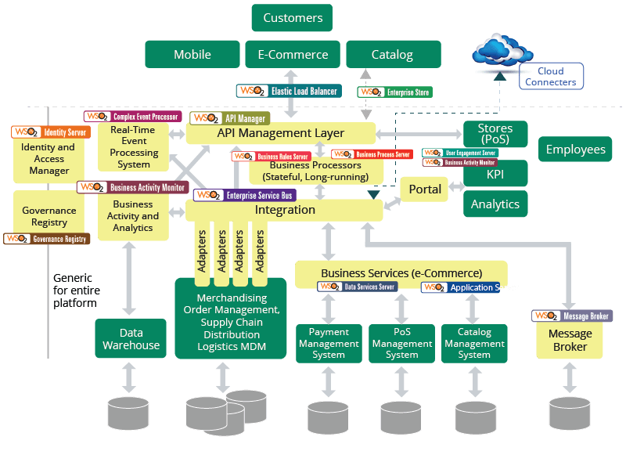

Slide 7

Vjekoslav Babić
24 minutes
Tests + Code + Documentation

Slide 8
What the agent actually did — in 24 minutes
Write
Tests
Run Tests
❌ FAIL
Write
Code
Run Tests
✅ PASS
Refactor
Code
Run Tests
✅ PASS
Mutation
Testing
Run Tests
❌ FAIL
Fix
Mutations
Run Tests
✅ PASS
Write
Docs
✅ DONE
All of this. No human wrote a line of code.

Slide 9
~600 hours → ~8 hours
Wair
Connector · Tests · Mapping app · Documentation

Slide 10
1
Custom
Agents
2
Skills
3
Reflection
Loop
4
Sub-agents
5
Background
Agents

Slide 11
01
Module 1: MCPs
Notes:
Concept intro placeholder — Module 1: Module 1: MCPs. Insert ~3–6 slides here.
---
[CONCEPT PREP NOTES]
Topics to cover:
What is an MCP and why it matters
Two install paths: VS Code marketplace vs. GitHub README 'install' button
The curated MCP list for today
Documentation demo: agent calls BC docs MCP to look up a feature. Keep under 3 min.

Slide 12
MCP Servers
Azure DevOps / GitHub – Refine tasks, review PRs
Bc-code-intel – AL Knowledge infusion
Al-symbols-mcp – Analyze the code of your dependencies
Telemetry Buddy – Analyze telemetry in natural language
YAMPI – Administer BC Environments
Serena – Stronger symbol analysis
AL Object ID Ninja – Stops ID conflicts
NAB AL Tools – Translation workflow for Copilot
MS Docs – Official documentation

Slide 13
Exercise 1.1
15 min
Install the curated MCPs
Objective: Get all attendees onto the same MCP baseline.
Open the workshop handouts repo (URL on screen)
Install these MCPs: Azure DevOps and Microsoft Learn / BC docs (VS Code will offer from mcp.json — accept)
Install Node.js LTS (nodejs.org) + run: gh extension install github/gh-copilot. Then reload VS Code.
Ask Copilot: “list your tools” — confirm all four appear
Watch out: AzDevOps MCP will ask which Microsoft account to use. If you've got Companial / 4PS / personal tenants, pick the one you registered for the workshop with — wrong choice means no work items.
Done when: The agent lists both MCPs in its tool inventory. And gh copilot --version prints a version number.

Slide 14
Exercise 1.2
15 min
Use each MCP once
Objective: See each MCP actually do its thing.
For each MCP on the list, run the matching prompt from the handout
Watch which tool gets called
Note one thing each MCP returned that was useful, surprising, or wrong
Done when: One chat per MCP, each showing the tool was called.
Notes:
Specifc tasks on how to use each of the MCPs

Slide 15

Module 1 — Debrief
Wooclap
"Which MCP surprised you most? Which one didn't work?"
Select your answer in Wooclap. We'll read it together.
Notes:
Keep this moving. One word or one sentence per person — go around the room or take raised hands. Don't let one person narrate their whole experience. Let’s approach Wooclap as well

Slide 16

Module 1 — Debrief
Slido
"Which MCP surprised you most? Which one didn't work?"
Drop one line into Slido. We'll read it together.
Notes:
Keep this moving. One word or one sentence per person — go around the room or take raised hands. Don't let one person narrate their whole experience. Let’s approach Wooclap as well

Slide 17
Module 1 — Debrief
Slido
"Which MCP surprised you most? Which one didn't work?"
Drop one line into Slido. We'll read it together.
Notes:
Keep this moving. One word or one sentence per person — go around the room or take raised hands. Don't let one person narrate their whole experience. Let’s approach Wooclap as well

Slide 18
Break — back in 15 minutes
9:00
9:30
10:30
10:45
12:00
13:00
14:15
14:30
15:30
16:30
Welcome
M1: MCPs
Break
M2: Agents
Lunch
M3: Sub-agents
Break
M4: Skills
M5: BG Agents
Closing
You are here
Notes:
Timetable — "you are here": Break (10:30).

Slide 19
02
Module 2: Custom agents
Notes:
Concept intro placeholder — Module 2: Module 2: Custom agents. Insert ~4–8 slides here.
---
[CONCEPT PREP NOTES]
Topics to cover:
The 'all tools enabled = 25k tokens for hello' demo
Anatomy of a custom agent: instructions, scoped toolset, chat mode
Community agents: brief look at one running on a sample work item (60–90s) — see what a stranger's agent looks like, then build your own
Documentation demo: Tine's documentation agent — instructions, scoped toolset, where it sits in the picker (~5 min). Structural mirror to what attendees build next.

Slide 20
Exercise 2.1
15 min
Build your own requirements analyst
Objective: A working requirements-analyst.agent.md you actually ran.
Use the /create-agent skill as your starting point
Define: name, description, instructions, toolset (include AzDevOps MCP)
Save and load it in VS Code
Tip: Don't try to make it perfect. We iterate in 2.2.
Done when: Your agent appears in the picker and accepts a prompt.

Slide 21
❌
✅
"The agent made a mistake.
Let me fix it by hand."
"The agent made a mistake.
Let me fix the skill."
→
You get better.
The agent stays the same.
You're the bottleneck.
Three months of this and you have
an agent that writes code
the way you do.
Don't fix yourself. Fix the agent.

Slide 22
Exercise 2.2
25 min
Iterate — let the agent absorb what good looks like
Objective: Experience fix-the-agent-not-the-mistake — and let the agent absorb best-practice guidance from the wiki.
Run your agent from 2.1 on the AzDevOps work item assigned to you. Note what's missing or wrong.
Open the AzDevOps wiki page Resources → Requirements (URL on screen).
Ask your agent: “Read these URLs and pull out the points a good requirements analyst should always check. Add the relevant ones to your own instructions.”
Re-run the agent on the same work item. Compare.
Identify one remaining thing it does worse — fix the agent's instructions, not the prompt. Re-run.
Tip: the agent reading the URLs is itself the demo — this is the pattern you take home.
Done when: You can name (a) one thing the agent absorbed from the wiki that improved its output, and (b) one instruction-level fix you made on top.
Notes:
This is where the community links come in.

Slide 23
Module 2 — Concept
Handoffs
Peer agents the user routes by hand
user clicks ↓
requirements-analyst
Create technical design ▶
tech-designer
handoffs:
- label: Create technical design
agent: tech-designer
prompt: Create a technical design for the requirement analysed above.
send: false
VS Code only — the handoffs: field is silently stripped by the GitHub Cloud Agent. No button = not supported there.
You click. The next agent starts. That's the difference from sub-agents.

Slide 24
Exercise 2.3
15 min
Hand off to a peer agent
Objective: Build a peer agent. Add one YAML block. Click the button.
Create .github/agents/tech-designer.agent.md — name, description, and short instructions for creating a technical design — data model, AL objects, integration points.
Add a handoffs: block to your requirements-analyst frontmatter — label, agent: tech-designer, a one-line prompt, send: false.
Run your requirements analyst on the assigned work item. When it finishes, look for the handoff button below the response.
Click it. Read the pre-composed prompt. Submit.
Done when: You clicked the handoff button. You can answer: who decided to route to the peer agent?

Slide 25
Module 2 — Capstone
Who's in charge?
Same building block. Who decides what fires next?
Pattern
Who routes?
custom agent
You — configured once, one job, one agent.
handoff
You — clicked a button after the agent finished.
sub-agent
The LLM — routes autonomously within the same turn.
Module 3 answer: what if you didn't click?

Slide 27
Lunch — back at 13:00
9:00
9:30
10:30
10:45
12:00
13:00
14:15
14:30
15:30
16:30
Welcome
M1: MCPs
Break
M2: Agents
Lunch
M3: Sub-agents
Break
M4: Skills
M5: BG Agents
Closing
You are here
Notes:
Timetable — "you are here": Lunch (12:30).

Slide 28
03
Module 3: Sub-agents
Notes:
Concept intro placeholder — Module 3: Module 3: Sub-agents. Insert ~5–8 slides here.
---
[CONCEPT PREP NOTES]
Topics to cover:
The transfer-order story — consultant analysing existing base app code
Context window blow-up, and sub-agents as the fix
The 'Run a task within an isolated sub-agent context' setting
Custom agents as sub-agents
Requirements analyst orchestrator example — set session target framing
Documentation demo: doc agent fans out — source-code reader, docs reader, style-guide checker (~5 min). Mirror of the analyst orchestrator.

Slide 29
Sub-agents
Parallel work, clean context
Without sub-agents
With sub-agents
Main agent
Main agent
returns reports
1. Load base app code
Sub-agent
base code
Sub-agent
docs
Sub-agent
guidelines
2. Load docs
Context window
3. Load guidelines
Context window
⚠ Summarizing chat history…

Slide 30
Exercise 3.1
15 min
Ad-hoc sub-agents
Objective: Feel the parallelism — see the context savings.
Take your requirements analyst from M2
Write a prompt that explicitly says "run each of these as a sub-agent" and lists three tasks: ambiguity check, dependency lookup, base app impact via AL Symbols MCP
Watch the sub-agent threads spin up
Done when: Three sub-agent threads ran and you got back a single consolidated summary.

Slide 31
Exercise 3.2
15 min
Bake the fan-out into the agent
Objective: Agent fans out without you asking.
Open your requirements analyst's instructions
Add guidance: when analysing a requirement, spin up sub-agents for ambiguity, dependencies, and base app impact
Re-run the same prompt — but without the explicit "run as sub-agent" clause
Done when: Agent fans out automatically.

Slide 32
Exercise 3.3
15 min
A custom agent, used as a sub-agent
Objective: Build a focused custom agent and have your requirements analyst delegate to it.
Create a focused custom agent — e.g., base-app-impact-analyzer.agent.md, scoped to AL Symbols MCP
Update your requirements analyst to call it by name as a sub-agent
Run end-to-end — same fan-out as 3.2, but one leg is now a named, purposeful agent
Done when: your orchestrator delegates to the named agent and returns a consolidated summary.
Tip: don't want this helper cluttering everyone's picker? Mark it not user-invocable. It still works as a sub-agent.

Slide 33
Module 3 — Debrief
Wooclap
"When do you stop subdividing?"
Drop one word or short phrase into Slido. Watch the cloud — the edges are where it gets interesting.
Notes:
This is a genuine design question with no single right answer. Push people to name a principle, not just a feeling.
Word cloud

Slide 34
Module 1 — Debrief
Slido
"Which MCP surprised you most? Which one didn't work?"
Drop one line into Slido. We'll read it together.

Slide 35
Break — back in 15 minutes
9:00
9:30
10:30
10:45
12:00
13:00
14:15
14:30
15:30
16:30
Welcome
M1: MCPs
Break
M2: Agents
Lunch
M3: Sub-agents
Break
M4: Skills
M5: BG Agents
Closing
You are here
Notes:
Timetable — "you are here": Break (14:45).

Slide 36
04
Module 4: Skills, and where everything else fits
Notes:
Concept intro placeholder — Module 4: Module 4: Skills, and where everything else fits. Insert ~4–6 slides here.
---
[CONCEPT PREP NOTES]
Topics to cover:
What a skill is: frontmatter + lazy body load
The layered improvement loop preview
Why .prompt.md files don't appear here — main treatment is in the closing
End on the matrix slide (M4.0) — that's the punchline before exercises
Documentation demo: a skill from Tine's docs agent — frontmatter, body, when it loads (~3 min).

Slide 37
Module 4 — Concept
What is a skill?
Instructions that load at the right moment — not all at once
name: + description:
Frontmatter — loaded every call. This is how the agent knows the skill exists and when to load it.
(body text)
Body — loaded lazily, only when the description matches the current task.
model: (optional)
Override which model runs when this skill fires.
The description is the trigger. The body is the payload.

Slide 38
Module 4 — Concept
When the agent fumbles
Three layers. One fix for each failure mode.
Skill loaded, wrong content
Fix: edit the skill body. Add the missing guidance.
Skill not loaded at all
Fix: improve the description. Make it specific about when to load.
Missing context every call
Fix: add to agent instructions. If the agent always needs it, it belongs there.
Ask the agent: what should I have given you up front? That tells you which layer.

Slide 39
Skills
Without a skill
Re-explain the workflow every single time.
“Build the BC app in PowerShell,
then publish it, then run the tests,
then collect the results...”
The agent only knows
what you told it today.
/run-tests
Build BC app
→ Publish
→ Run tests
→ Report results
Write once.
Discovered automatically.
Called directly. Every time.

Slide 40
Exercise 4.1
15 min
Draft a v1 skill
Objective: A skill file your agent actually picks up.
Pick a workflow where your requirements analyst currently fumbles or wastes loops
If you can't think of one, build the INVEST-check skill — a skill that runs an INVEST checklist over acceptance criteria. Frontmatter: "load when reviewing acceptance criteria"; body walks Independent / Negotiable / Valuable / Estimable / Small / Testable.
Write the skill — frontmatter (name + description) and body
Save it into the right location for the agent to discover
Verify the agent picks it up when relevant
Done when: The skill is loaded by the agent in the right context.

Slide 41
Module 4 — M4.0
Where does everything fit?
This is the picture we just drew — keep it in mind as you build.
Surface
What it's for
agents.md / claude.md / Copilot instructions
Always-on, project-wide context every agent needs
Custom agent instructions
Persona + scope for this agent's job
Skill frontmatter (name + description)
When should this be loaded?
Skill body
What should the agent do when it's loaded?
Static prompt files (.prompt.md)
One-off pattern; we mostly don't use these (see closing)
Same content can technically live in any of these. The trick is putting it where it'll actually be loaded at the right moment.

Slide 42
What to use when
Custom Agents
Specific workflow, specific tools, specific persona.
You define the job description
and exactly what it can touch.
Skills
Reusable know-how, packaged once.
Agents discover and invoke when relevant.
Can also be called directly.
Instructions (copilot-instructions.md)
Always-on context and rules for the project.
Active every session —
the agent’s standing orders.
.prompt.md — Stored Prompts
REDUNDANT NOW
Anything stored here can be a skill instead.
Skills are invoked directly and discovered
automatically — stored prompts add nothing.

Slide 43
Exercise 4.2
15 min
Layered improvement loop
Objective: Experience all three layers — instructions, skill body, skill description.
Run the workflow with the skill loaded — let it fumble or wander
Ask the agent: "what should I have given you up front?"
Decide where the fix belongs: agent instructions, skill body, or skill description
Apply the fix in the right layer. Re-run.
Tip: If the agent didn't load the skill at all, the fix is almost always in the description.
Done when: You can name (a) one concrete thing the agent told you to add, and (b) which layer you put it in, and why.

Slide 44
Module 4 — Debrief
Slido
"What other skill would you build?"
One line into Slido. We're collecting the surprises.
Notes:
Go fast. You want volume here — the surprises stack. Write them on a whiteboard if you have one.

Slide 45
Module 1 — Debrief
Slido
"Which MCP surprised you most? Which one didn't work?"
Drop one line into Slido. We'll read it together.

Slide 46
Up next: Module 5 — Background agents
9:00
9:30
10:30
10:45
12:00
13:00
14:15
14:30
15:30
16:30
Welcome
M1: MCPs
Break
M2: Agents
Lunch
M3: Sub-agents
Break
M4: Skills
M5: BG Agents
Closing
You are here
Notes:
Timetable — "you are here": M5: BG Agents (16:00).

Slide 47
05
Module 5: Background agents
Notes:
Concept intro placeholder — Module 5: Module 5: Background agents. Insert ~4–6 slides here.
---
[CONCEPT PREP NOTES]
Topics to cover:
The session-target picker
Where an agent can run: VS Code local, Copilot CLI (and why front-runners moved to the terminal)
The two-agents-one-file problem
Git worktrees as the fix
The apply-changes-back-to-workspace flow
Documentation demo: tooltip-update task to Copilot CLI with worktree, Tine visibly switches back to other work (~4 min). The 'I'm not watching it' moment is the lesson.

Slide 48




Agent frameworks
Task
Task
GitHub
Task
Model
Tools
Model
Tools
Model
Tools
Task
Task
CLI
Model
Tools
Model
Tools

Slide 49
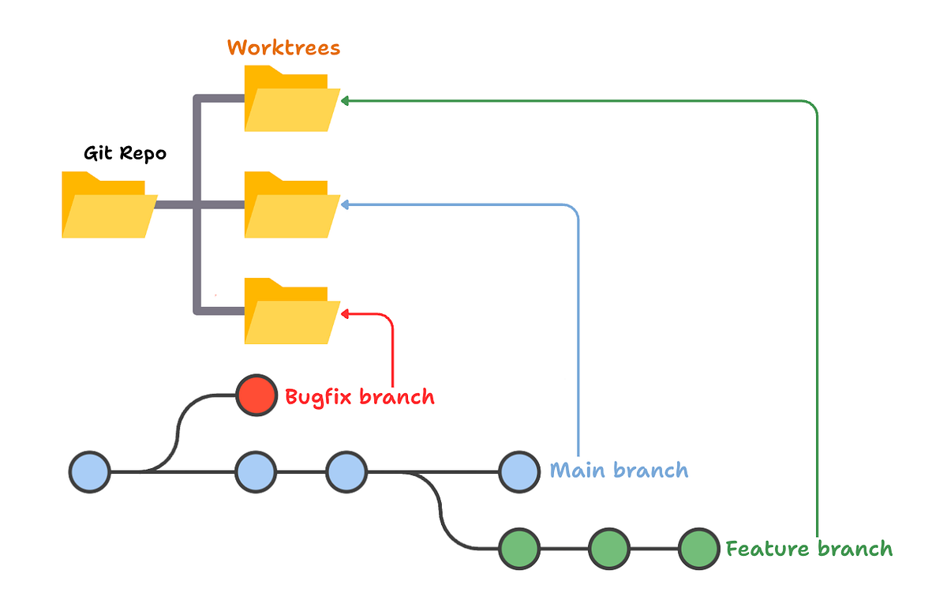

Slide 51
Exercise 5.1
15 min
One task, off to the background
Objective: Run an agent without watching it.
Open a docs file from the handout (the tooltip-update task)
Set session target to Copilot CLI, isolation mode to worktree
Send the task. Don't watch it.
Switch back to VS Code. Finish anything you didn't get through in M4 — or get coffee. Don't sit and stare.
Come back. Review the diff. Apply the changes you want.
Done when: You ran an agent without watching, and you applied (or rejected) its changes.

Slide 52
Module 5 — Debrief
Slido · binary
+ Open mic
“Did giving up the visibility feel freeing, or wrong?”
Slido first — drop a single vote: freeing or wrong. Then open mic for whoever wants to defend their pick.
Notes:
Don't push for a 'correct' answer. Both reactions are legitimate. The interesting follow-up: what would you need to trust it more?

Slide 53
Module 1 — Debrief
Slido
"Which MCP surprised you most? Which one didn't work?"
Drop one line into Slido. We'll read it together.

Slide 54
Closing
9:00
9:30
10:30
10:45
12:00
13:00
14:15
14:30
15:30
16:30
Welcome
M1: MCPs
Break
M2: Agents
Lunch
M3: Sub-agents
Break
M4: Skills
M5: BG Agents
Closing
You are here
Notes:
Timetable — "you are here": Closing (16:45).

Slide 55
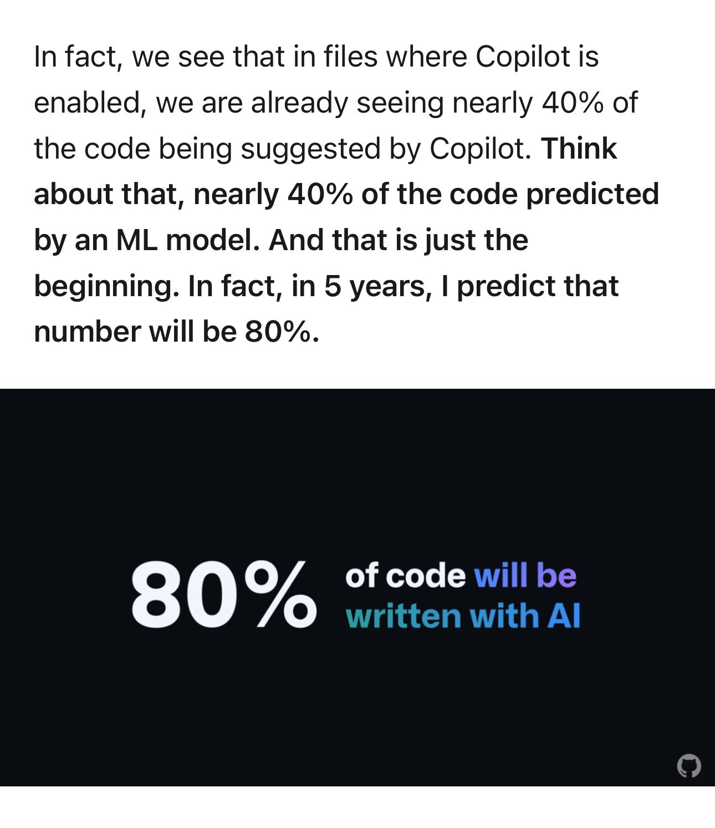
Notes:
They don’t plan, the output text that looks like they do They don’t solve problems, they output text that looks like solutions
They don’t think, they output text that seems like they do
3 ways of org adoption
Just show them
Make it all for them
Let them explore

Slide 56
LLMs don’t hallucinate 20% of the time.
They hallucinate 100% of the time and they just happen to be right 80% of the time.

Slide 57
LLMs don’t hallucinate 20% of the time.
They hallucinate 100% of the time and they just happen to be right 80% of the time.

Slide 58
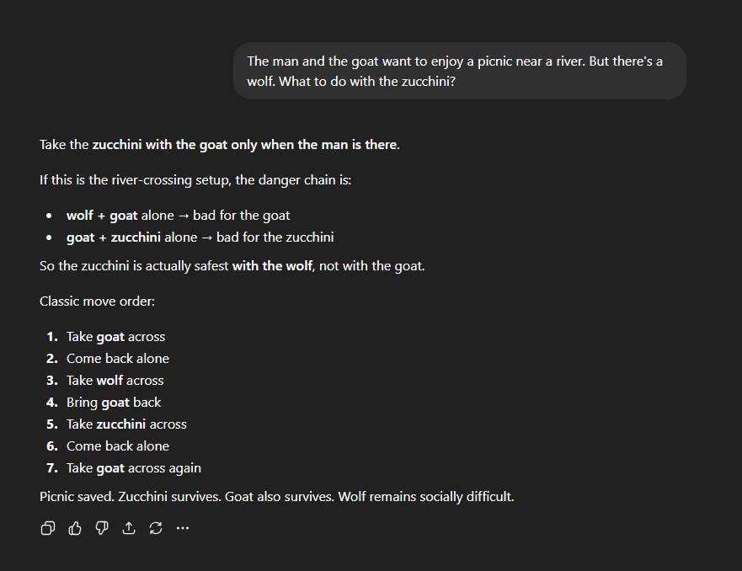
Notes:
The man and the goat want to enjoy a picnic near a river. But there's a wolf. What to do with the zucchini?

Slide 59


Complete Garbage
Most Amazing things I’ve ever seen

Slide 60
1
Custom
Agents
2
Skills
3
Reflection
Loop
4
Sub-agents
5
Background
Agents

Slide 61
What we didn't cover, and why.
Stored prompt files (.prompt.md) — useful pattern — but the what-goes-where? framing in M4 is the better lesson
GitHub Cloud Agent — neither of us uses it day-to-day
Code review — out of scope for this audience — code analysis (M3) is the more useful framing
Vendor-specific agents (Claude Code, Codex) — different licenses, different ergonomics
Code generation itself — the whole other workshop — today gives you the building blocks
Test plans — happy to dig in at Q&A — Luc's full internal write-up is on the AzDevOps wiki for take-home
If you use one of these — share what's worked. The team learning is half the value.
Notes:
Don't apologise for the gaps — frame them as scope choices. Keep it under two minutes.

Slide 62
Stay in touch. Send us what you tried.
Go home, try this on your own work. In the next three weeks, send us anything — two new MCPs you discovered, an agent you built that surprised you, a skill that fixed a workflow you'd been working around. We'll respond. Comments, pointers, where to look next. If you want into the wider BC-on-AI community, we'll help you in.
Tine Starič · LinkedIn: /in/tinestaric · tine@staric.net
Luc van Vugt · LinkedIn: /in/lucvanvugt · lvanvugt@fluxxus.nl

Slide 63
Q&A — and what you'll do on Monday.
Q&A
Anything we didn't get to today. Anything you wish we'd spent more time on.
Monday morning
Pick one thing from today. What's the smallest version of it you can do at work tomorrow?
Tine Starič · LinkedIn: /in/tinestaric · tine@staric.net Luc van Vugt · LinkedIn: /in/lucvanvugt · lvanvugt@fluxxus.nl
Notes:
The question is the main event — the contact info is secondary. Give the room a moment to think before taking questions.

